Slide 1

nBlocksStudio Solving a simple Motion Control Automation Use Case
Nikolaos Chalikias
06/12/2020
Notes:
Hello,
In this presentation we solve a Motion Control Automation use case, to demonstrate, nBlocksStudio... Diagram to Microprocessor executable workflow
The

Slide 2
THE USE CASE
We have a linear motion system, and we want:
To start the motion when the start Button is pressed
To reverse the motion when the Right End-Switch is reached
To Stop when the Left End-Switch is activated

Slide 3
LIMITING REQUIREMENTS
ELECTRONICS COST 25 EURO
EASY TO PURCHASE
MICROCONTROLLER BOARD
MOTOR-DRIVER BOARD
OPTIONS FOR PROFESSIONAL GRADE BOARDS

Slide 4
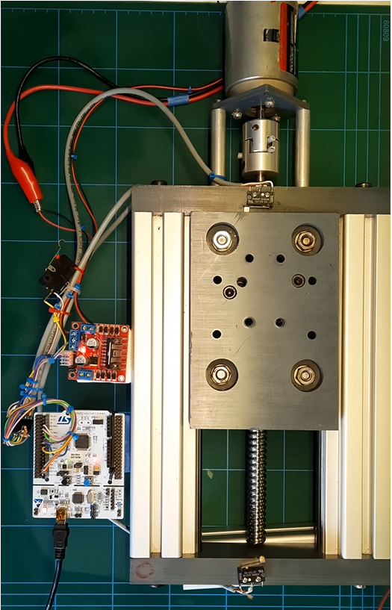
SYSTEM DETAILS
MOVING
CARRIAGE
LEFT
END-SWITCH
DC MOTOR
RIGHT
END-SWITCH
BALL SCREW
COUPLER
L298 MOTOR
DRIVER
BOARD
START-SWITCH
MICROPROCESSOR
BOARD
NUCLEO F401
Notes:
An example of a simple motion control automation, implemented with nBlocksStudio.
The Mechanical frame
A Linear motion stage made with Aluminum profiles, 14mm hardened shafts, A carriage with V-Groove ball bearings, Ball screw & Nut, a Shaft-Coupler and the DC-Motor
Interface to electronics:
The End micro-switches
A brushed DC 24VA Motor
The Electronics
The Microcontroller board, is a low cost Nucleo STM32F401.
The Motor Driver is a low cost L298 breakout board
Our use case is:
To Start moving the carriage right when the Start button is pressed.
When the right endswitch is reached the motion is reversed.
Then when the left endswitch is reached, the motion stops

Slide 5
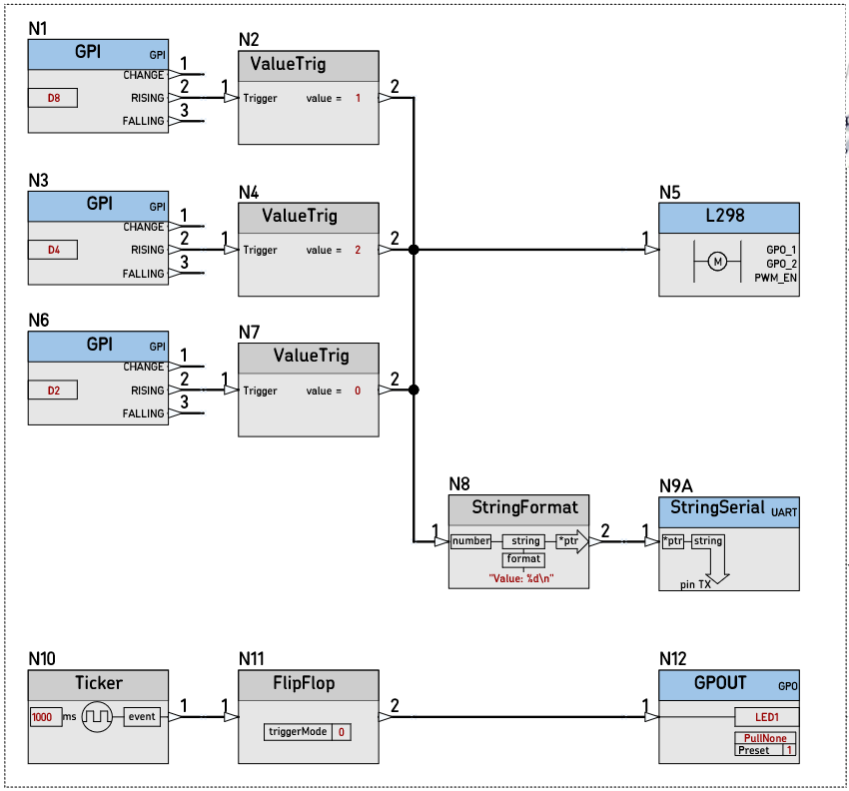
DESIGN with nBlocksStudio
nBlocksStudio
Notes:
We are using nBlocksStudio Schematic DESIGN.
We can use a wide range of 32-Bit ARM Cortex-M Microprocessors supported by ARM-mbed
The differences in our Design would be
The different Pins used for the Switch Inputs
The different Output pins for the Motor driver

Slide 6
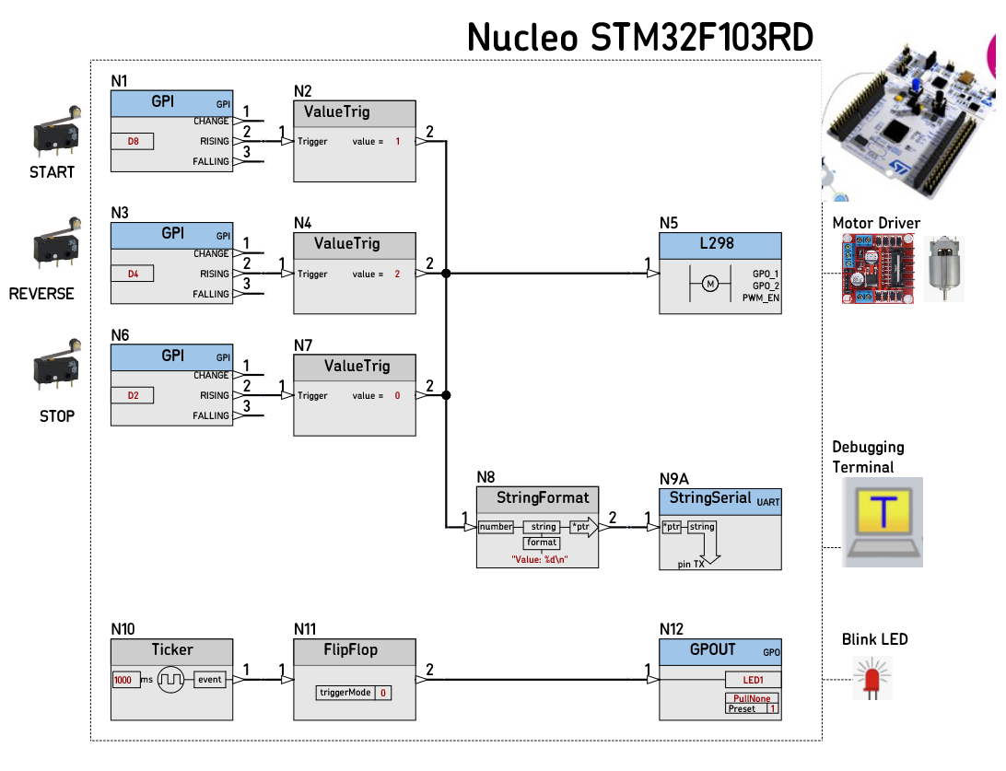
DESIGN DETAILS
Notes:
In this example, are using a 3d party Schematic Software, combined with our nBlocksStudio Schematic Libraries.
Here we have added some images to our design to indicate the system interconnections.
We can see on the Left the micro-switches
And on the right the serial terminal and the Motor Driver Board
When the Schematic Design is complete, we are ready for the next step

Slide 7
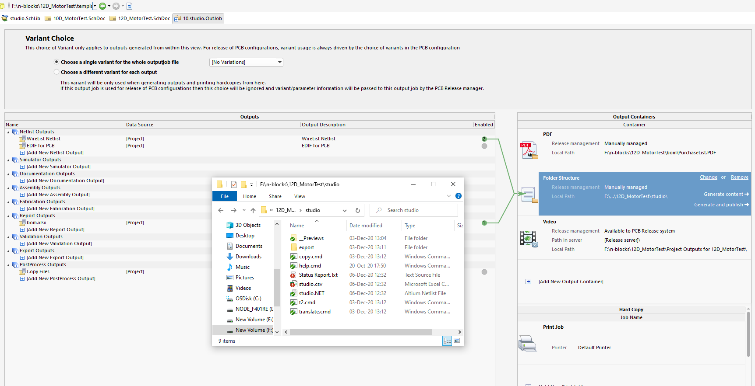
DESIGN EXPORT
Notes:
We export the Design, and 2 files are created:
The .NET file that contains the Netlist information
The .CSV file that contains the parameters for each Node
These 2 files will be processed in the next step, from the Command Line tool.
This tool is the nBlocksStudio-Translator!

Slide 8
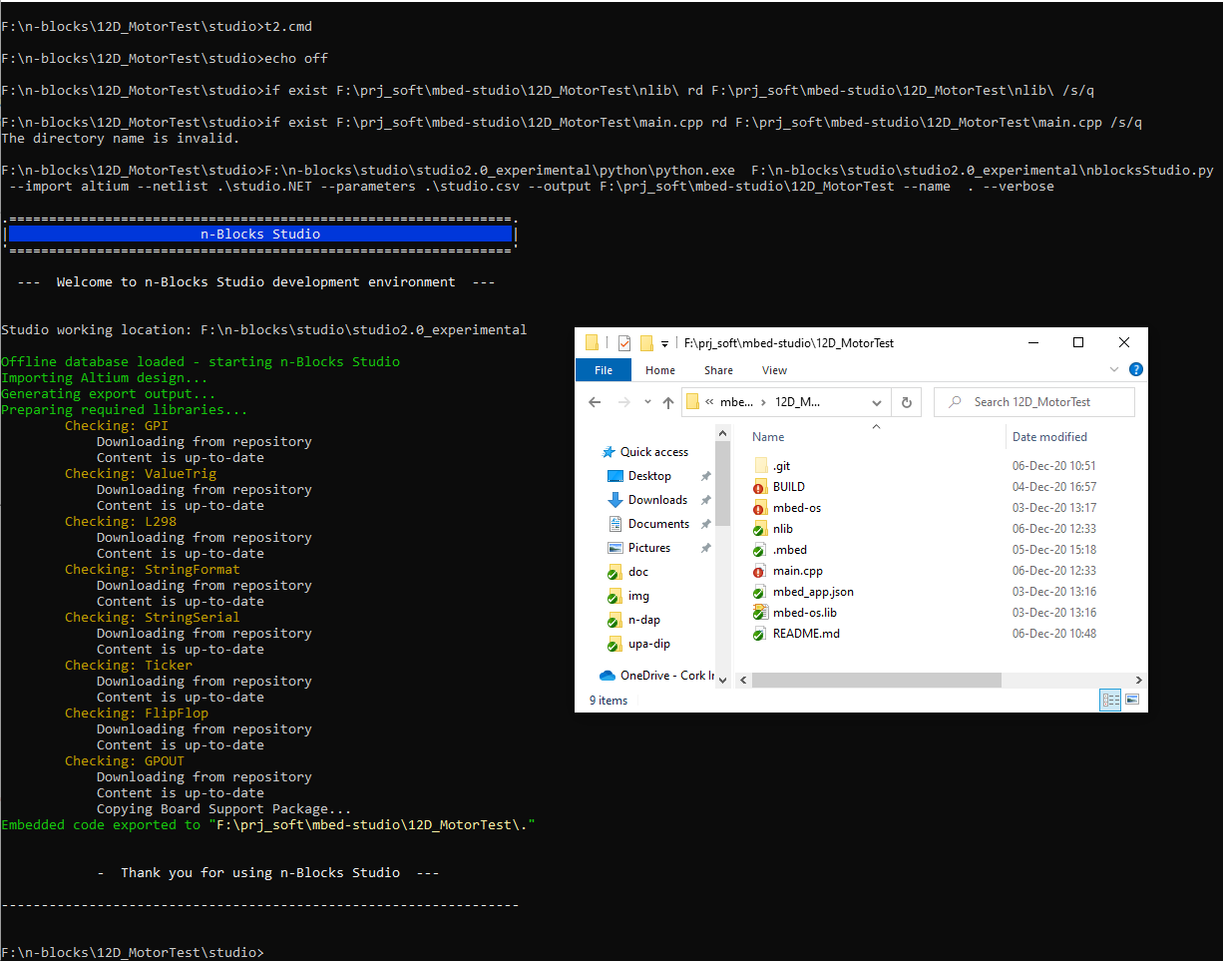
DESIGN TRANSLATION
Notes:
The nBlocksStudio Translator tool, will create a new Folder with contents:
The autogenerated main.cpp file, containing our design and
The nLib subfolder with:
all the Libraries and C++ for each Node
The nBlocksStudio Kernel
The contents of the nLib subfolder are git version controlled and are downloaded from remote github repositories.
This allows to lock a design on specific library version(s)
Or
Use the latest.
If there is no Internet connection, the nLib content can be created from local sources.

Slide 9
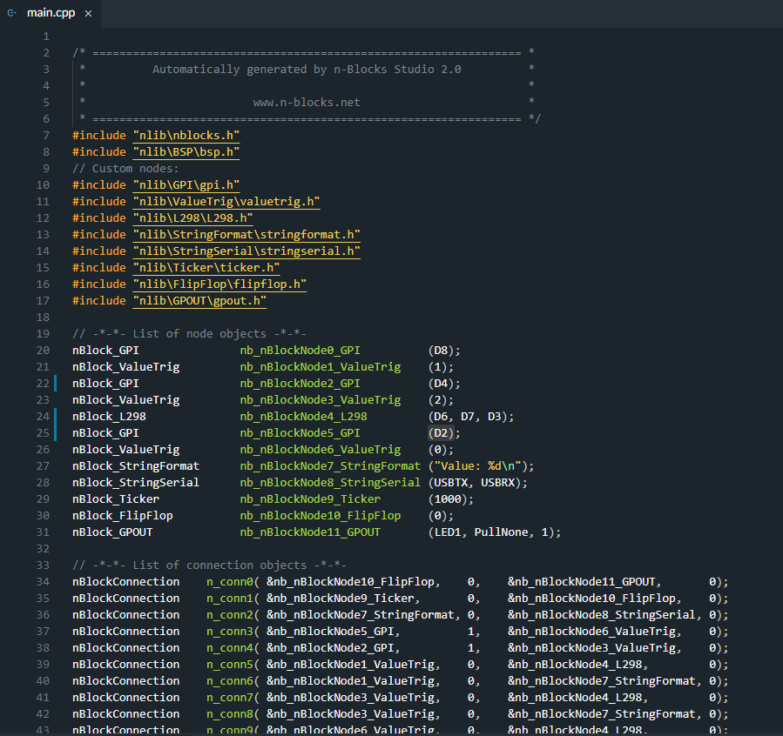
AUTOGENERATED CODE
Notes:
This is the newly created main.cpp.
The size is small and is easy to review and understand.
It is also possible to update some parameters before compilation to facilitate debugging.

Slide 10
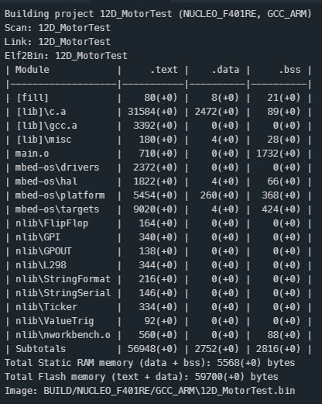
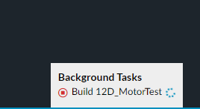
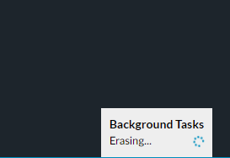
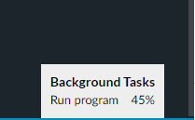
COMPILATION AND DOWNLOAD TO MCU
Notes:
The Next step is the compilation and the executable download to our microprocessor.
The IDE in use is mbed-studio and we have set it up for the GCC Compiler.
ARM AC6 compiler is also an option.
The IDE can compile and erase/flash/run the executable in a single step

Slide 11
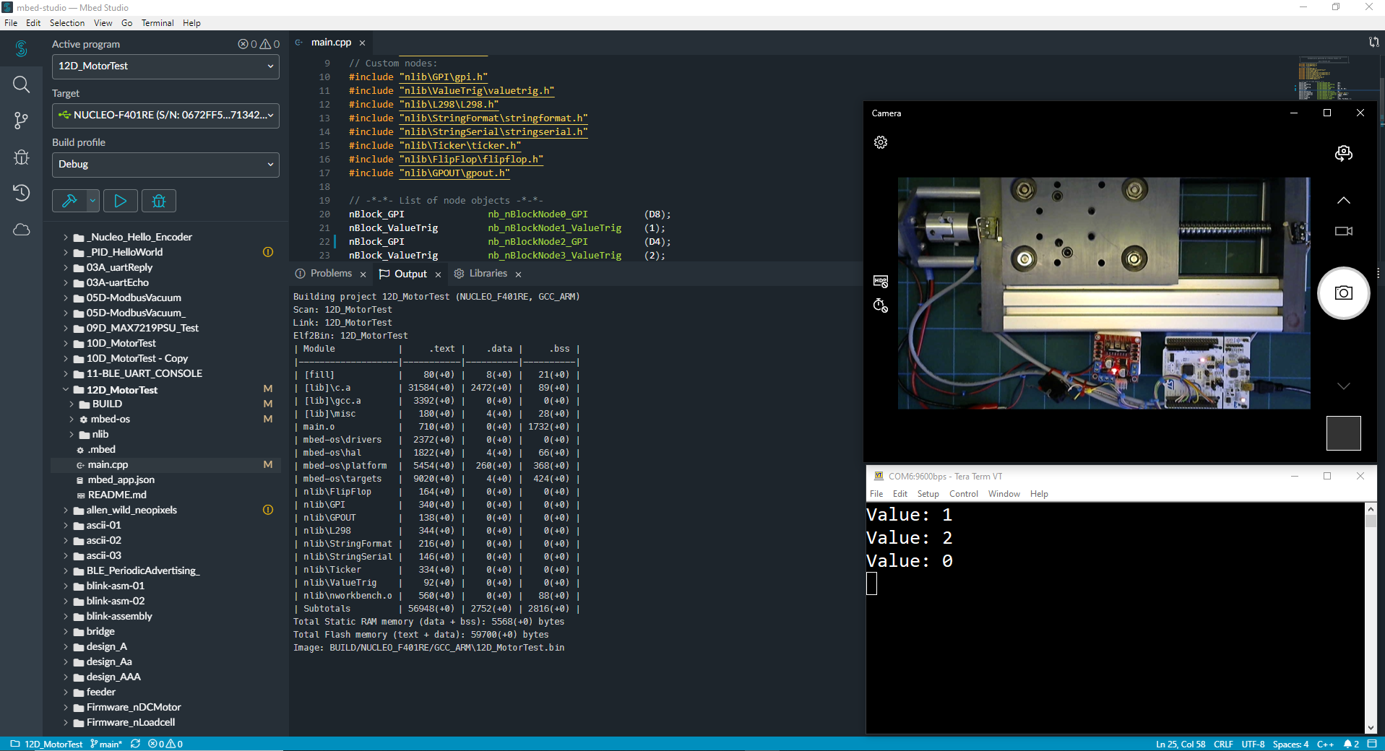
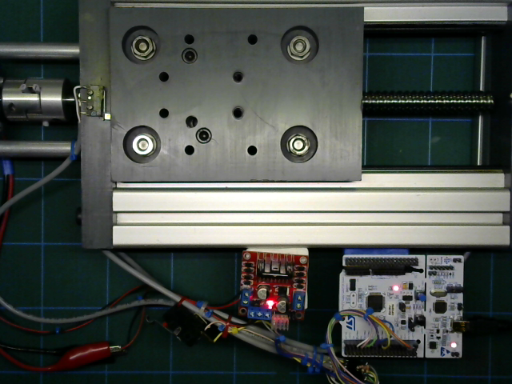
EXECUTE THE DESIGNED MOTION
Notes:
After the microprocessor is programmed, we are ready for the testing.
We initiate the movement, pressing the start Switch
And
We can see the motion executed.

Slide 12
NEXT nBlocksStudio EXAMPLE
Motion Control
Incremental Encoder
Reading
Notes:
Next
Our next nBlocksStudio Motion control example will read the Motor Incremental Encoder to have precise indication of the motor and carriage position

